Slide 1
Movies
Recommandation System
Project Proposal
Big Data Application: Machine Learning at Scale
Instructor: Master Quach Dinh Hoang

Slide 2
Members
Trần Công Tuấn Mạnh 19133035
Trần Phát Đạt 19133018
Trần Quốc Tuấn 19133064
Nguyễn Lâm Sơn 19133050

Slide 3
Table of contents
01
02
03
The project
Project goals
Datasets
04
05
Models
Evaluate

Slide 4
The project
The problem that our project wants to resolve is recommended movies based on an old dataset.
From data on a CSV file, we can process, analyze, and train it to build a system that can become a better recommendation system.
Then apply the evaluate functions to evaluate models to choose the best models.

Slide 5
2. The project goals
The project goal is to discover information from data, process, and analyze statistics to get the most useful information from the data.
Then use a recommendation system built from old datasets and use SparkML to recommend movies based on the information of the user, movies, ratings, timestamps, and tags.

Slide 6
3. Datasets
This dataset describes 5-star rating and free-text tagging activity from [MovieLens](http://movielens.org), a movie recommendation service. It contains 25,000,095 ratings and 1,093,360 tag applications across 62,423 movies. These data were created by 162,541 users between January 09, 1995 and November 21, 2019. This dataset was generated on November 21, 2019.

Slide 7
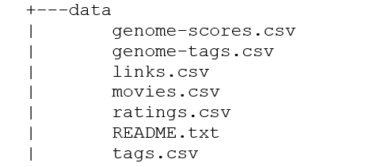
3. Datasets
This is movie data set about each customer's rating for each movie they watch
Link Data: https://files.grouplens.org/datasets/movielens/ml-25m.zip

Slide 8







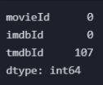







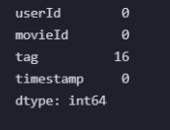
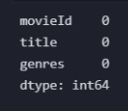


Slide 9
4. Models
Content-based system:
Evaluate the properties of recommended item
Collaborative filtering:
The system suggests items based on the similarity between users and/or items.

Slide 10
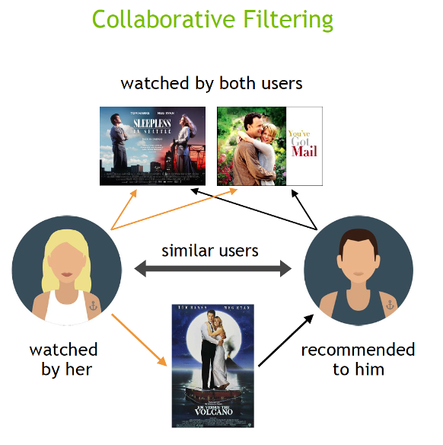

Slide 11


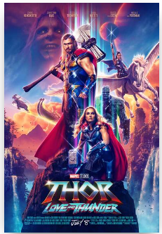

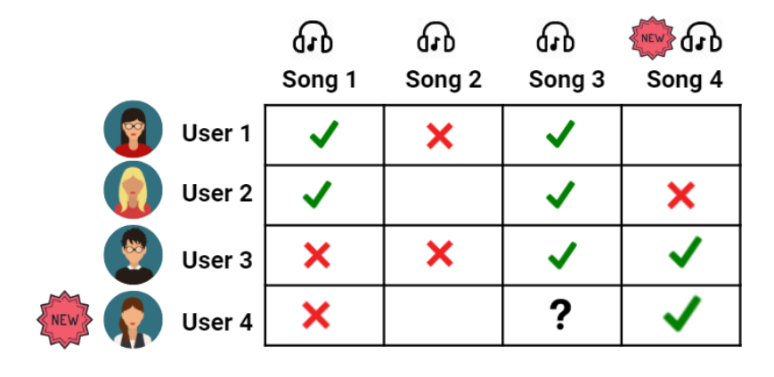

Build a Recommender System (collaborative filtering)

Slide 12
5. Evaluation
Hold out (70/30)
Cross-Validation
Measure: RMSE

Slide 13
THANK YOU

